Slide 1


Introduction to Strategic Planning for Scale
1
Revising Business Models for Scalability
2
Market Analysis for Expansion Opportunities
3
Strategic Planning for Growth Trajectories
4
Scale vs. Sale
5
Understanding the Business Cycle

Slide 2

What is a Scalable Business Model
1
Definition of a scalable business model
2
Focus on growth without increasing costs

Slide 3
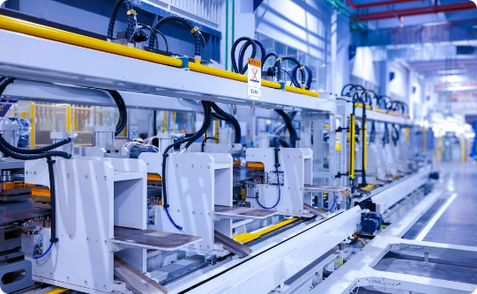


What is a Scalable Business Model
Streamlined Operations
Leveraging Technology
Flexible Cost Structure
Scalable businesses have well-defined, repeatable processes that can be easily replicated for expansion, ensuring rapid growth without complexity.
Harnessing technology like automation and cloud computing enables efficient scaling, allowing businesses to adapt to changing needs.
Scalable models prioritize low fixed costs and high variable costs, driving profitability as revenue grows.

Slide 4



Key Elements of a Scalable Business Model
Importance of standardized processes
Benefits
Consistency
Standardized processes are crucial for creating a scalable business model. They provide a foundation for consistent operations and growth.
Reduced errors
Lower training costs

Slide 5
Key Elements of a Scalable Business Model
Technology integration for efficiency
Flexible cost structures for scalable growth
Outsourcing for flexibility and focus
Technology integration for efficiency
Flexible cost structures for scalable growth
Outsourcing for flexibility and focus

Slide 6
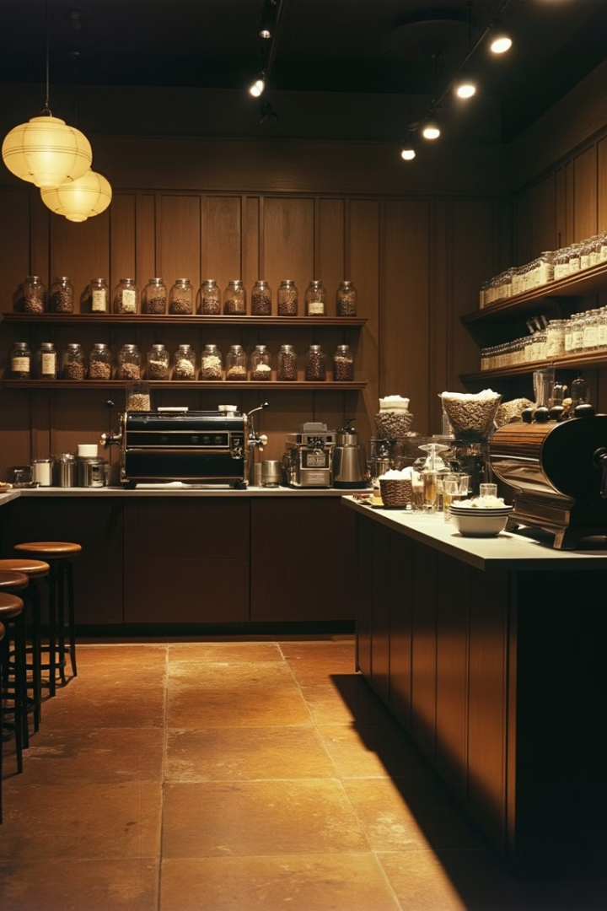
Case Study: Starbucks' Initial Model
1
Starbucks' Initial Business Model
Starbucks' initial business model focused on providing high-quality coffee and a unique café experience. The company started as a single store in Seattle, emphasizing premium coffee beans and a cozy atmosphere.
2
Early Growth and Expansion
As Starbucks gained popularity, it began to expand to more locations. However, this growth highlighted the need for a more scalable approach to maintain consistency across stores.
3
Realization of the Need for Scalability
Starbucks recognized that to achieve widespread success, they needed to develop a business model that could be easily replicated across different locations while maintaining the quality and experience that made them popular.

Slide 7




Case Study Part 1: Starbucks' Scalable Model
Standardization
Standardization of recipes and store layouts
Consistency
Consistent customer experience
Efficiency
Reduced training costs and maintained quality

Slide 8
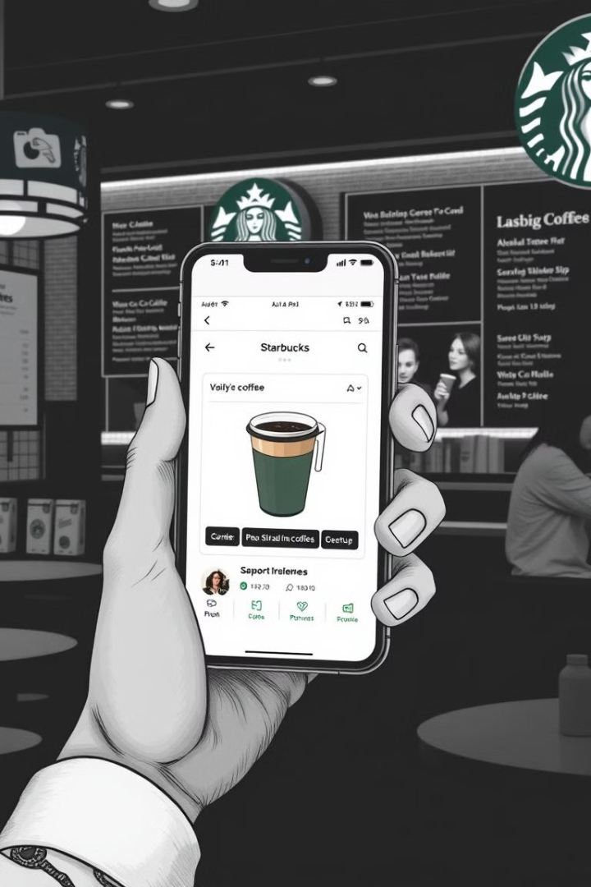

Case Study Part 2: Leveraging Technology and Flexible Costs at Starbucks
Introduction of the Mobile App
Mobile app for enhanced customer
engagement while increasing efficiency
and reducing labor costs

Slide 9
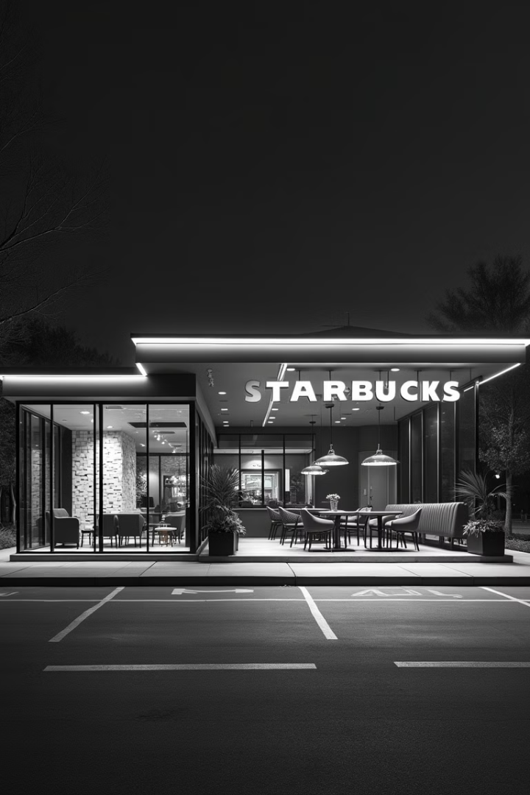


Case Study Part 2: Leveraging Technology and Flexible Costs at Starbucks
Flexible Store Formats
Adapting to Diverse Market Needs
Drive-thrus
Express stores
Starbucks adapts its store formats to meet the needs of different markets and locations.

Slide 10



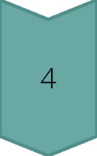
Steps to Revise Your Business Model for Scalability
Assessing the current model
Conduct a SWOT analysis to evaluate your business model's current state
Understanding strengths
Identify and analyze the strengths of your current business model
Recognizing weaknesses
Pinpoint and assess the weaknesses in your existing business model
Importance of understanding
Recognize the critical role of understanding both strengths and weaknesses in revising your business model for scalability

Slide 11

Steps to Revise Your Business Model for Scalability
1
Identify scalable components
2
Integrate technology
Integrate technology into your business processes to improve efficiency and enable rapid expansion.
Identify scalable components in your business model to focus on areas with the most potential for growth.
3
Develop a flexible cost structure
4
Pilot and iterate strategies
Develop a flexible cost structure that can adapt to changing market conditions and business needs.
Pilot and iterate strategies to test and refine your scalable business model before full implementation.

Slide 12
Summary of Key Strategies
Standardization
Technology
Flexible Costs
Outsourcing
Standardization is a crucial strategy for scalability. It involves creating consistent processes and procedures across the organization, allowing for efficient replication and growth.
Leveraging technology is essential for scaling a business. It can automate processes, improve efficiency, and enable rapid expansion without a proportional increase in costs.
Implementing flexible cost structures allows businesses to adapt quickly to changing market conditions and scale operations up or down as needed.
Outsourcing non-core functions can help businesses focus on their key competencies while still accessing necessary services, enabling faster and more efficient scaling.

